Slide 1
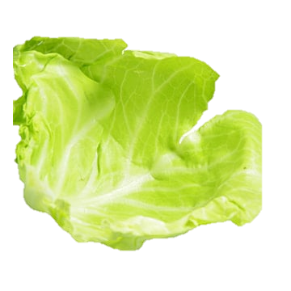
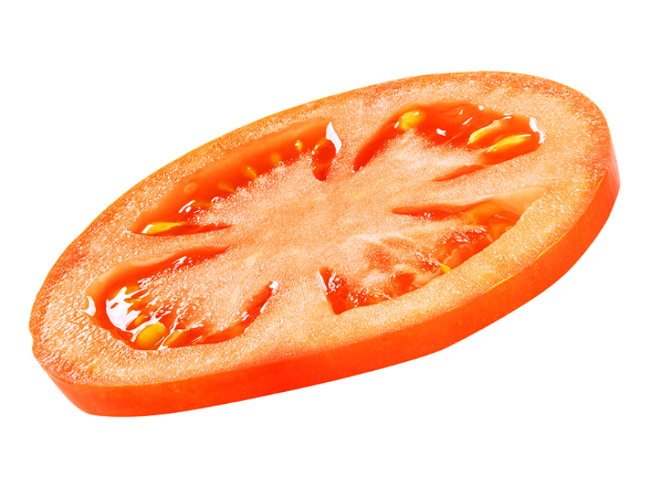


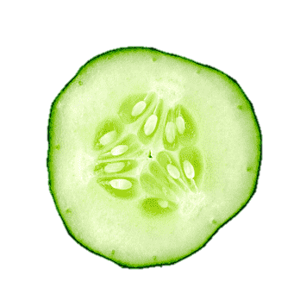


HEALTHY
FOOD

Slide 2
HEALTHY
FOOD

Slide 3
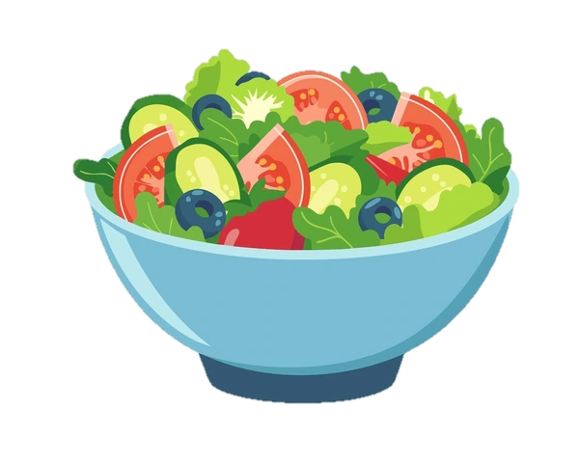
HEALTHY
FOOD

Slide 4
What is Healthy Food?
Healthy food is food that provides the
Essential nutrients our body needs to
function properly, grow, and stay strong. It
Includes items rich in vitamins, minerals,
Proteins, fiber, and healthy fats, such as
Fruits, vegetables, whole grains, lean
Meats, nuts and dairy.

Slide 5
Importance of Healthy Food
Healthy food provides essential nutrients that keep our body
Strong and energized. It helps prevent diseases, boosts
immunity, and supports overall well-being. Eating nutritious
meals improves mental clarity, focus, and mood. It also
Promotes healthy growth, repair of body tissues,
and long- term vitality.

Slide 6
Types of Healthy Food
Healthy foods include fruits and veggies like leafy greens (spinach, kale), berries (blueberries, strawberries), and root
vegetables (sweet potatoes, carrots). Whole grains
like brown rice and oats provide fiber and energy.
Lean proteins, such as chicken, fish, tofu, and beans, support muscle growth. Healthy fats from avocados, nuts
(almonds, walnuts), and olive oil promote heart and brain health.

Slide 7
Foods To Avoid
Processed and Sugary Foods: Foods like candies, pastries, and sugary drinks should be limited, as they are high in empty calories and can lead to weight gain, heart disease, and diabetes.
Trans Fats and Fried Foods: Items like fast food, chips, and baked goods often contain trans fats, which raise bad cholesterol levels and lower good cholesterol.

Slide 8
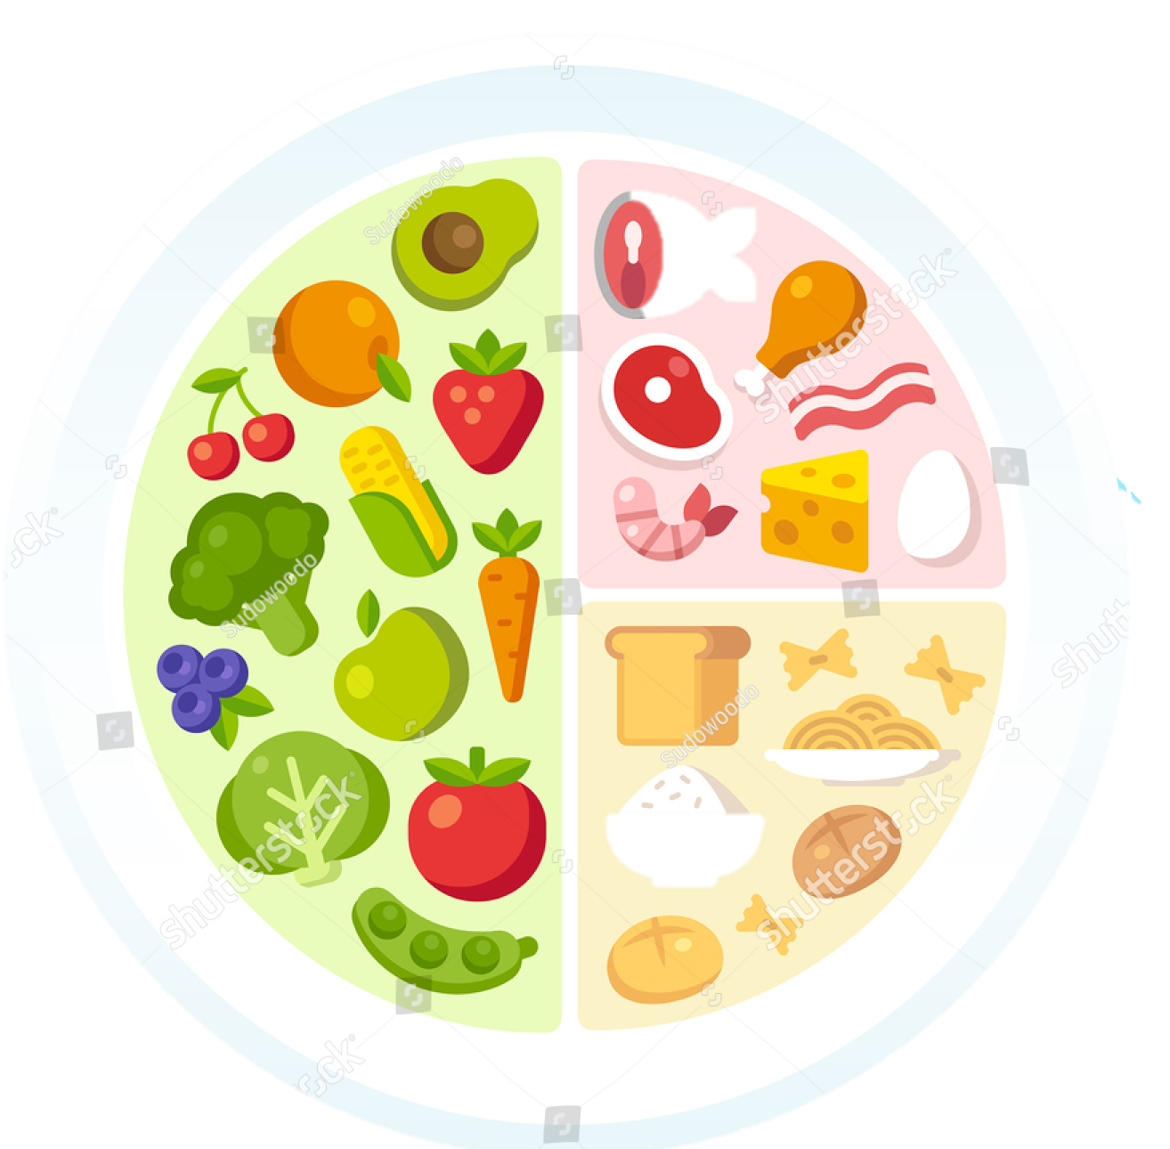
Healthy Diet
A healthy diet means eating a balanced mix of whole foods like fruits, vegetables, whole grains, proteins (such as lentils, eggs, or fish), and healthy fats from nuts and seeds, while limiting processed foods, excess sugar, and salt. It supports your body’s Metabolism, keeps energy levels stable, and helps prevent diseases like Type 2 Diabetes. Drinking enough water and maintaining consistent eating habits are just as important as choosing the right foods.

Slide 9
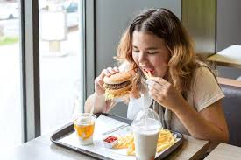
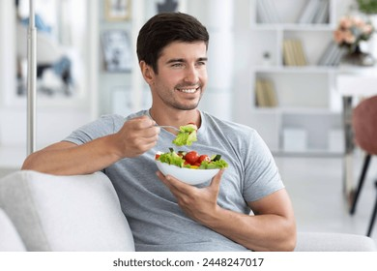

Slide 10
Swap unhealthy snacks for better choices.

Slide 12
Choose fresh, wholesome meals every day.

Slide 13
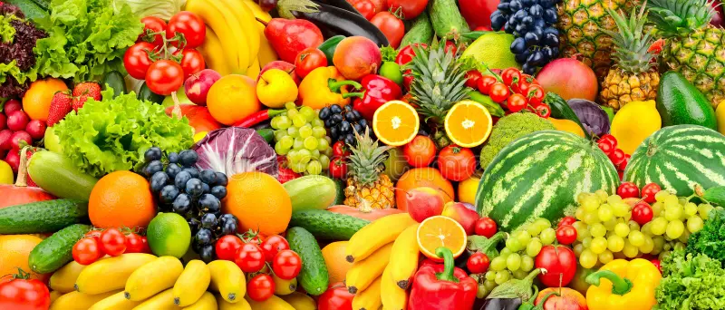
THANK
YOU

